Slide 1
Lecture 5.1 Horizontal Differentiation

Slide 2
Horizontal Differentiation
We have two shops at each end of a street 10km apart. Consumers prefer to eat nearby. (We considered this example in week 3 in the context of monopolistic competition.)
100 hungry customers evenly distributed along street
0
10
L
R
Esme’s sandwich shop
Jose’s taco shop

Slide 3
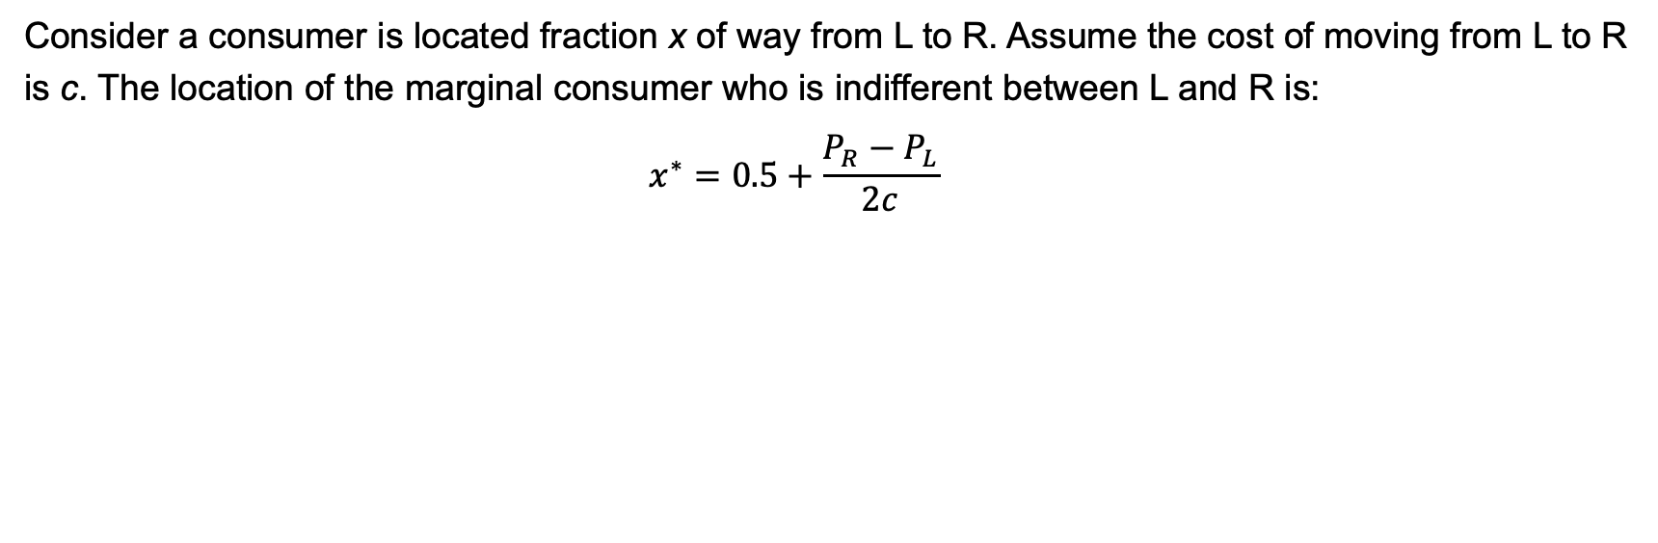
Horizontal Differentiation
Consider a consumer is located fraction x of way from L to R. Assume the cost of moving from L to R is c. The location of the marginal consumer who is indifferent between L and R is:
$$x^{∗}=0.5+\frac{P_{R}−P_{L}}{2c}$$
100 hungry customers evenly distributed along street
0
10
L
R
Esme’s sandwich shop
Jose’s taco shop

Slide 4
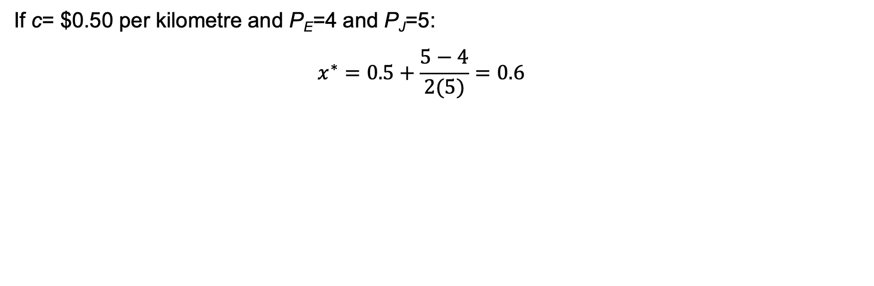
Horizontal Differentiation
If c= $0.50 per kilometre and P_{E}=4 and P_{J}=5:
$$x^{∗}=0.5+\frac{5−4}{2(5)}=0.6$$
100 hungry customers evenly distributed along street
0
10
L
R
Esme’s sandwich shop
Jose’s taco shop

Slide 5
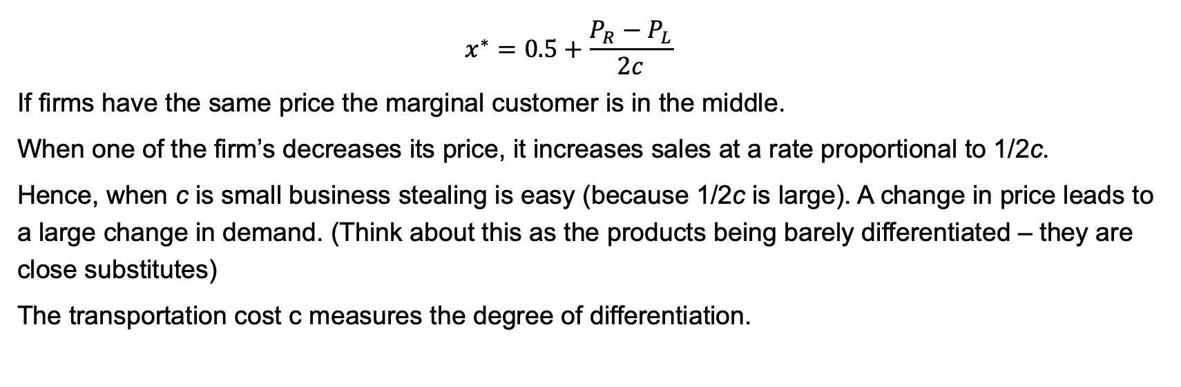
Horizontal Differentiation
$$x^{∗}=0.5+\frac{P_{R}−P_{L}}{2c}$$
If firms have the same price the marginal customer is in the middle.
When one of the firm’s decreases its price, it increases sales at a rate proportional to 1/2c.
Hence, when c is small business stealing is easy (because 1/2c is large). A change in price leads to a large change in demand. (Think about this as the products being barely differentiated – they are close substitutes)
The transportation cost c measures the degree of differentiation.

Slide 6
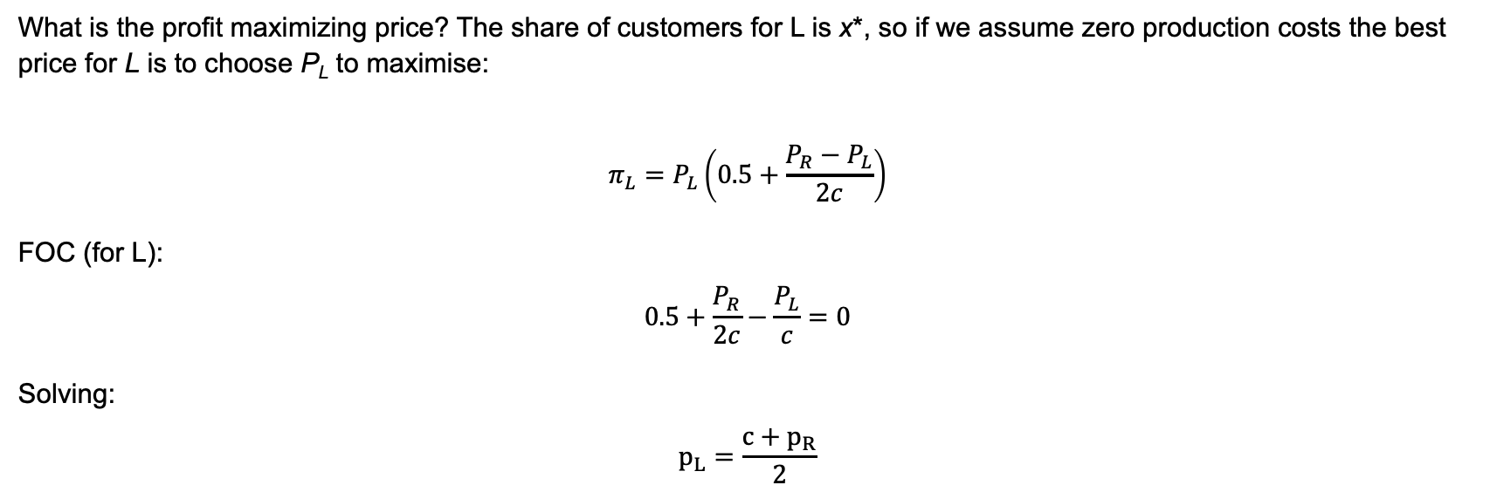
Horizontal Differentiation
What is the profit maximizing price? The share of customers for L is x*, so if we assume zero production costs the best price for L is to choose P_{L} to maximise:
$$π_{L}=P_{L}\left(0.5+\frac{P_{R}−P_{L}}{2c}\right)$$
FOC (for L):
$$0.5+\frac{P_{R}}{2c}−\frac{P_{L}}{c}=0$$
Solving:
$$p_{L}=\frac{c+p_{R}}{2}$$

Slide 7
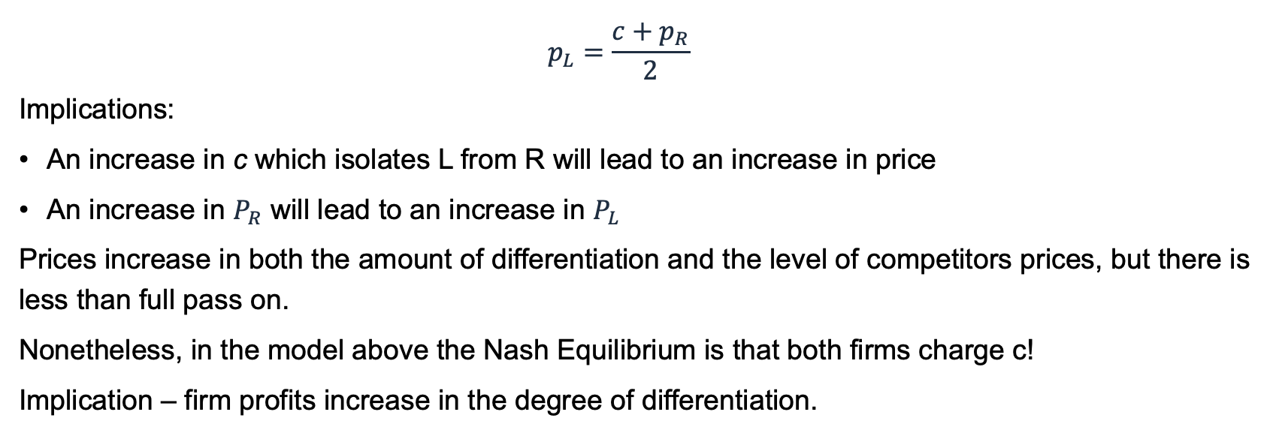
Horizontal Differentiation
$$p_{L}=\frac{c+p_{R}}{2}$$
Implications:
An increase in c which isolates L from R will lead to an increase in price
An increase in $P_{R}$ will lead to an increase in $P_{L}$
Prices increase in both the amount of differentiation and the level of competitors prices, but there is less than full pass on.
Nonetheless, in the model above the Nash Equilibrium is that both firms charge c!
Implication – firm profits increase in the degree of differentiation.

Slide 8
Endogenous location
Now ask what the model looks like if we hold prices constant. In this case the model becomes one of location choice.
Moving from L to R, this causes the marginal consumer to move from the L to the R.
Similarly, the firms on the R will have an incentive to move to the L, causing the marginal consumer to move from the R to the L….
L
R

Slide 9
Endogenous location
Where to the firms end up?
In the middle.
This is why it is claimed that many firms end up offering something similar.
This reasoning is not just confined to firms, but also political parties who try to capture the middle ground.

Slide 10
Endogenous Location
Note that this result applies for two firms but not for many.
Suppose that there were four firms and they were all in the middle.
What do you think might happen?
So what might the result end up looking like?

Slide 11
Endogenous location
We will discuss this in the tutorial, but we would expect in this case:
Firms 1 and 2
Firms 3 and 4
0
0.25
0.75
1

Slide 12
Endogenous Prices and Location
What happens when prices are adjustable along with firm location?
When prices are flexible you want to be further away from your rivals.
When firms choose best responses (for fixed location) the price was equal to set price equal to c: the transportation cost between the two locations.
The higher this distance is the greater is the price and the greater are the profits for each of the firms.
The key constraint is that when you get further away from each other, what is likely to happen?

Slide 13
Endogenous Prices AND LOCATION
What does your location do to other firm’s price?
When you move further away from your competitor you tend to increase your own price and also help your competitor.
Why?
Intuitively, for the competitor, the competition is further away and it has a higher price!
But then, the firm that moves away also gets a flow on benefit of the competitor raising its own price.

Slide 14
Horizontal Differentiation
We don’t need to confine our differentiation to that of geography or physical location.
Breakfast Cereals
Not sweet
Sweet
Chips
Healthy
Heart attack inducing
Movies
Period drama
Action

